Slide 1
EARLY DETECTION OF CHRONIC KIDNEY DISEASE USING MACHINE LEARNING
SHIBANI SENTHIL KUMAR - 2019115095
SHIVANI KUJULUVA KARTHIKEYAN - 2019115096
SNEHA TIROUMOUROUGANE - 2019115099
TREASA GEORGE – 2019115115

Slide 2
DOMAIN : APPLIED DATA SCIENCE
PROBLEM STATEMENT : Chronic Kidney Disease (CKD) is a major medical problem and can be cured if treated in the early stages. Usually, people are not aware that medical tests we take for different purposes could contain valuable information concerning kidney diseases. Consequently, attributes of various medical tests are investigated to distinguish which attributes may contain helpful information about the disease. The information says that it helps us to measure the severity of the problem and we make use of such information to build a machine learning model that predicts Chronic Kidney Disease.

Slide 3
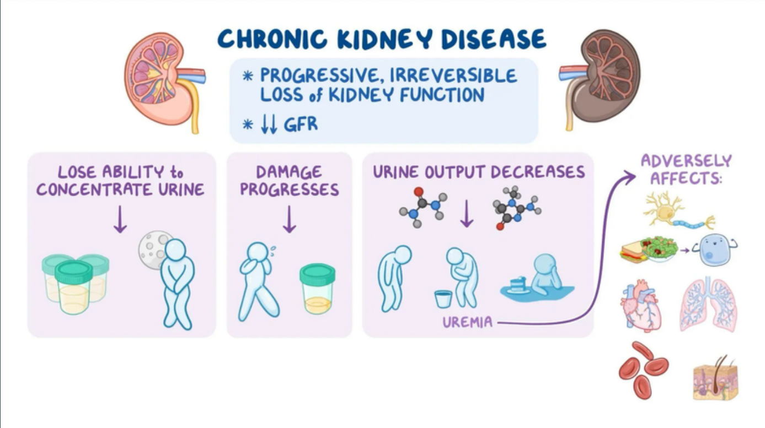

Slide 4
INTRODUCTION
Chronic Kidney Disease (CKD) is a major medical problem and can be cured if treated in the early stages. The goal is to use machine learning algorithms to assess the underlying prediction of severe renal infections, also known as extreme kidney diseases. The main causes of chronic kidney disease include excessive blood pressure and diabetes. A person with chronic kidney disease (CKD) is more likely to pass away at a young age. The main goal of this project is to detect several illnesses linked to CKD in order to avert the disease. This project offers a novel machine learning approach for early CKD detection and prediction.

Slide 5
Early detection of chronic kidney disease using machine learning Abrar, Tahmid Tasnim, Samiha Hossain, Md.Mehrab
Abrar et.al have used four techniques of master teaching are explored including Support Vector Regressor (SVR), logistic Regressor (LR), AdaBoost, Gradient Boosting Tree and Decision Tree Regressor. The components are made from UCI dataset of chronic kidney disease and the results of these models are compared to determine the best regression model for the prediction. From this four preprocessing cases, replacing missing values with mean values of each column and choosing important features was most logical as it allows to train with more data without dropping. However, XGBoost gave the best outcomes in all four cases where it obtained 98% accuracy in case one where nulled valued are dropped, 98.75% testing accuracy for both case two and three where null values were replaced with minimum and maximum values of each column and it scores 100% accuracy in case four where null values are replaced with mean values. Thus, the system can be implemented v for early stage CKD prediction in a cost efficient way which will be helpful for under developed and developing countries.

Slide 6
Detection of Chronic Kidney Disease Using Machine Learning Algorithms with Least Number of Predictors Tomas E Ward, Marwa Almasoud
Tomas E Ward and Marwa Almasoud found that hemoglobin has higher importance for both random forest and Gradient boosting in detecting CKD. Finally, results are among the highest compared to previous studies but with less number of features reached so far. This work examines the ability to detect CKD using machine learning algorithms while considering the least number of tests or features. We approach this aim by applying four machine learning classifiers: logistic regression, SVM, random forest, and gradient boosting on a small dataset of 400 records. In order to reduce the number of features and remove redundancy, the association between variables have been studied. A filter feature selection method has been applied to the remaining attributes and found that there are hemoglobin, albumin, and specific gravity have the most impact to predict the CKD. The classifiers have been trained, tested, and validated using 10-fold cross-validation. Higher performance was achieved with the gradient boosting algorithm by F1-measure (99.1 %), sensitivity (98.8%), and specificity (99.3%)

Slide 7
Chronic Kidney Disease Prediction using Machine Learning Reshma S , Salma Shaji , S R Ajina , Vishnu Priya S R, Janisha A
Reshma et.al study the use of machine learning techniques for CKD such as Ant Colony Optimization(ACO) technique and Support Vector Machine(SVM) classifier. Final output predicts whether the person is having CKD or not by using minimum number of features. A wrapper method used here for feature selection is ACO. ACO is a meta-heuristic optimization algorithm. Out of the 24 attributes present 12 best attributes are taken for prediction. Prediction is done using the machine learning technique, SVM. In this classification problem SVM classifies the output into two class with CKD and without CKD. The main objective of this study was to predict patients with CKD using less number attributes while maintaining a higher accuracy. Here we obtain an accuracy of about 96 percentage.

Slide 8
A Novel Approach to Predict Chronic Kidney Disease using Machine Learning Algorithms Bhavya Gudeti, Shashvi Mishra, Shaveta Malik, Terrance Frederick Fernandez, Amit Kumar Tyagi, Shabnam Kumari
Bhavya Gudeti et.al main purpose was to study and analyze the Chronic Kidney Disease dataset and conduct CKD and Non CKD classification cases. This research work has idolized Rcode to compare their performance. The models obtained from CKD patients are trained and authenticated with the mentioned input parameters. Support Vector Machine, Logistic Regression and knn are analyzed to conduct the study of CKD. The performances of those algorithms were determined primarily on the basis of precision. Our results exemplified that the Support Vector Machine algorithm predicts Chronic Kidney Disease better than Logistic Regression and K-Nearest Neighbors within the narrow limits of this medical scenario.

Slide 9
Predictive analytics for chronic kidney disease using machine learning techniques Anusorn Charleonnan, Thipwan Fufaung, Tippawan Niyomwong, Wandee Chokchueypattanakit, Sathit Suwannawach
Anusorn Charleonnan et.al have used Four machine learning methods are explored including K-nearest neighbors (KNN), support vector machine (SVM), logistic regression (LR), and decision tree classifiers. These predictive models are constructed from chronic kidney disease dataset and the performance of these models are compared together in order to select the best classifier for predicting the chronic kidney disease. From the experimental results, it can be seen that the SVM classifier gives the highest accuracy than the others with 98.3% while Logistic, Decision Tree and KNN can produce the average accuracy of 96.55%, 94.8% and 98.1 % respectively.

